Slide 1
Some discrete probability distributions
Md. Shahidul Salim
Lecturer, CSE, KUET

Slide 2
Binomial and Multinomial Distributions
An experiment often consists of repeated trials, each with two possible outcomes that may be labeled success or failure.
The process is referred to as a Bernoulli process. Each trial is called a Bernoulli trial.
The Bernoulli process must possess the following properties:
The experiment consists of repeated trials.
Each trial results in an outcome that may be classified as a success or a failure.
The probability of success, denoted by p, remains constant from trial to trial.
The repeated trials are independent.

Slide 3

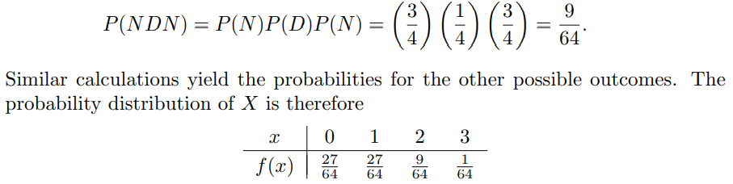
Consider the set of Bernoulli trials where three items are selected at random from a manufacturing process, inspected, and classified as defective or nondefective. A defective item is designated a success.
Since the items are selected independently and we assume that the process produces 25% defectives, we have

Slide 4
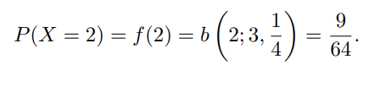
Binomial Distribution
The number X of successes in n Bernoulli trials is called a binomial random variable.
The probability distribution of this discrete random variable is called the binomial distribution, and its values will be denoted by b(x; n, p)
The probability of x successes in n trials for a binomial experiment.
First, consider the probability of x successes and n − x failures in a specified order.
Since the trials are independent, we can multiply all the probabilities corresponding to the different outcomes.
Each success occurs with probability p and each failure with probability q = 1 − p. Therefore, the probability for the specified order is p^{x}q^{n−x}.

Slide 5
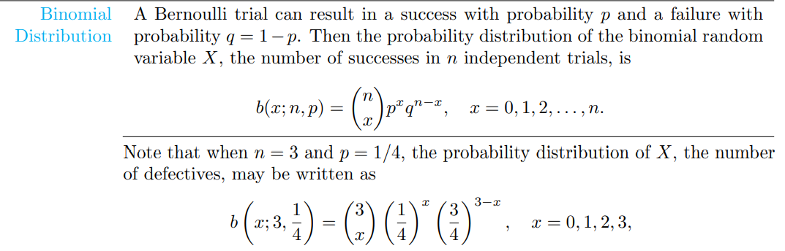
Binomial Distribution

Slide 6
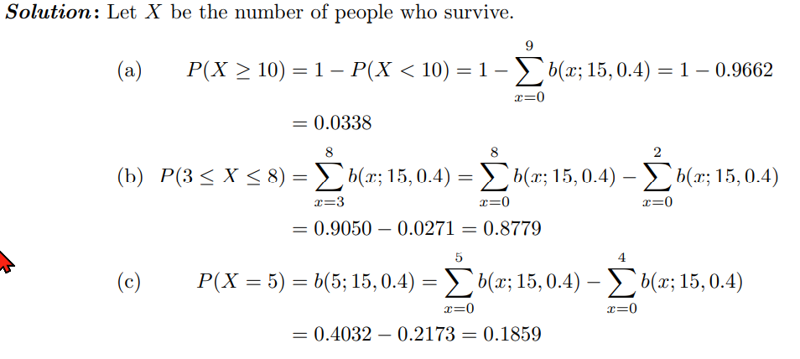

Slide 7
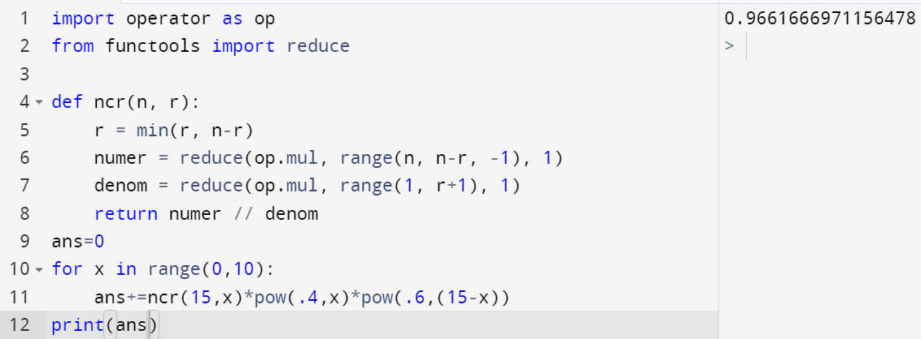
Answer

Slide 8
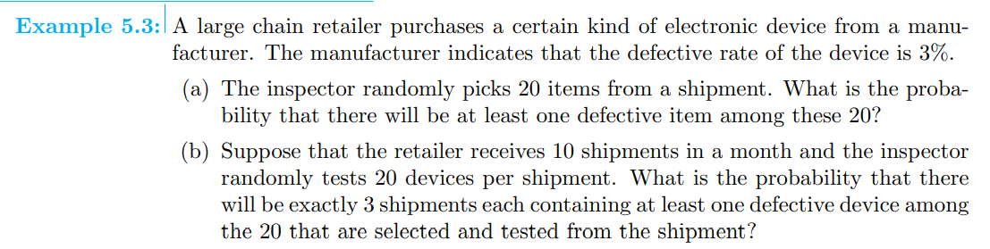
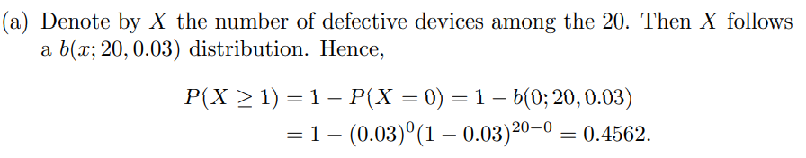
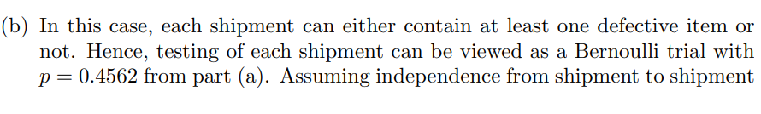
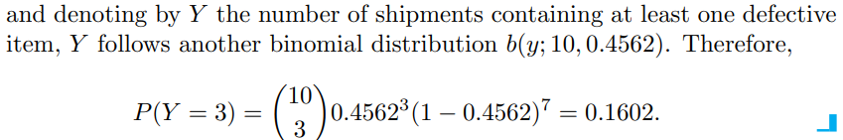

Slide 9
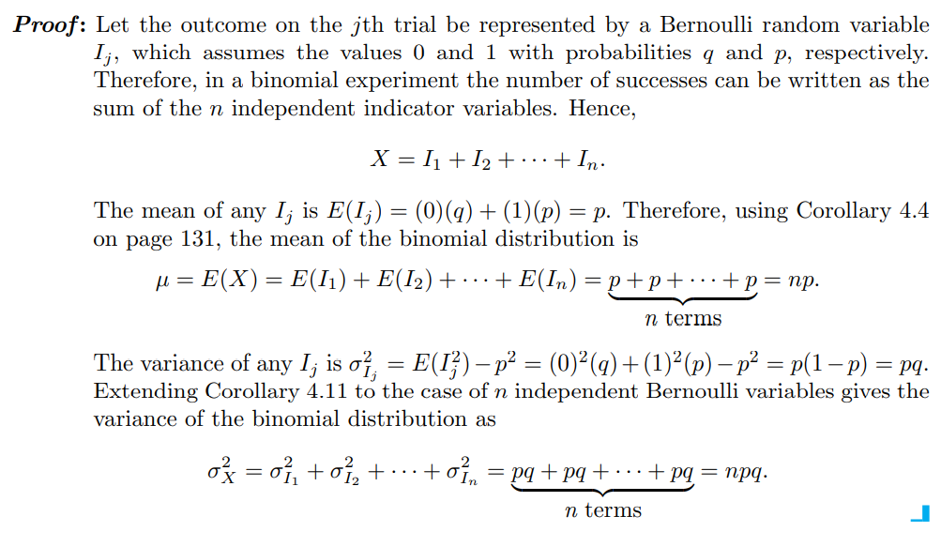

Slide 10
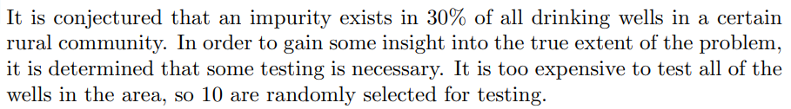
Find the mean and variance.
n=10
p=.3
q=.7
Mean=np
Variance=npq

Slide 11
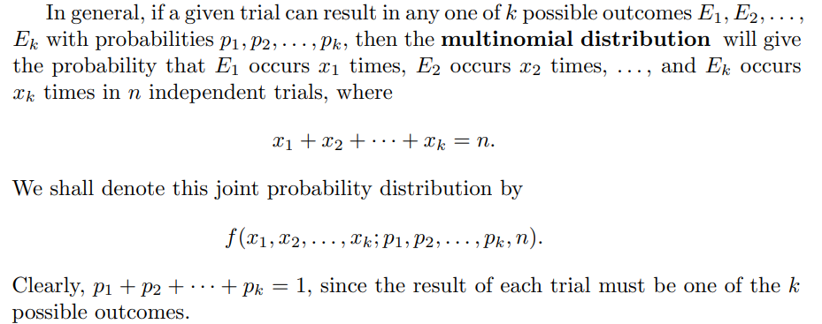
Multinomial Experiments and the Multinomial Distribution
The binomial experiment becomes a multinomial experiment if we let each trial have more than two possible outcomes.

Slide 12
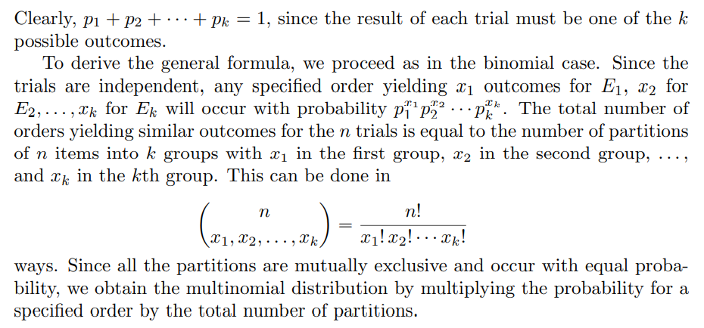

Slide 13
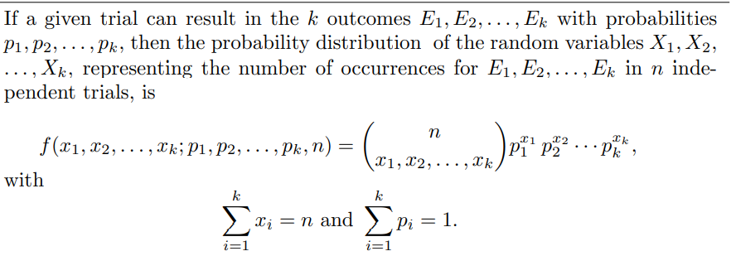
Multinomial Distribution

Slide 14
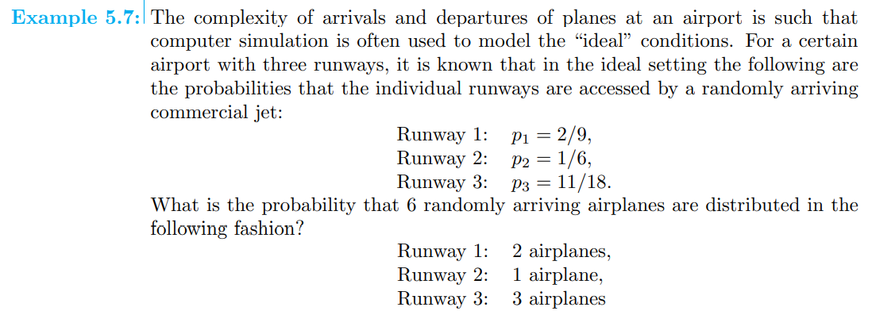
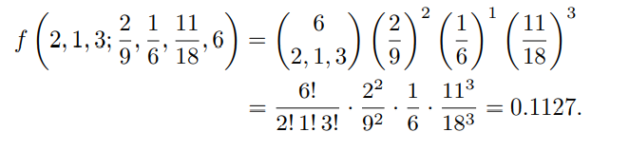

Slide 15
Hypergeometric distribution
Binomial distribution, independence among trials is required
The sampling must be done with replacement of each item after it is observed.
The hypergeometric distribution does not require independence and is based on sampling done without replacement.
Applications : acceptance sampling, electronic testing, and quality assurance.

Slide 16
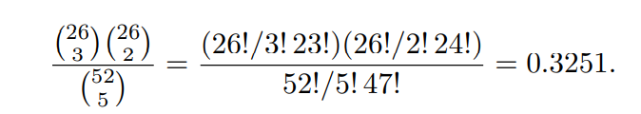
If 5 cards are drawn at random, we are interested in the probability of selecting 3 red cards from the 26 available in the deck and 2 black cards from the 26 available in the deck.
There are 26C3 ways of selecting 3 red cards, and for each of these ways we can choose 2 black cards in 26C2 ways.

Slide 17
Hypergeometric distribution
The hypergeometric experiment has the following two properties:
1. A random sample of size n is selected without replacement from N items.
2. Of the N items, k may be classified as successes and N − k are classified as failures.
Hypergeometric distribution, and its values are denoted by h(x; N, n, k),

Slide 18
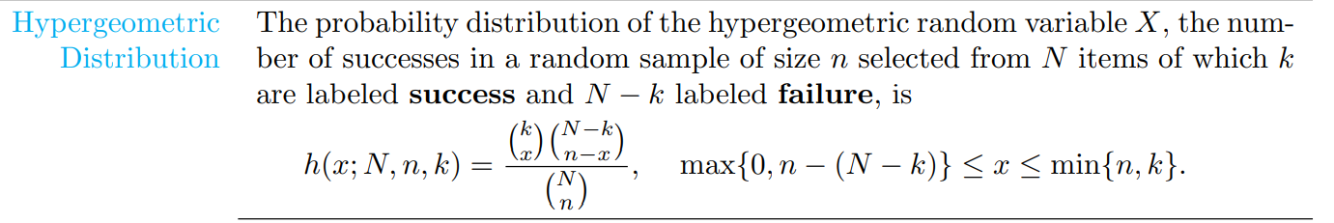
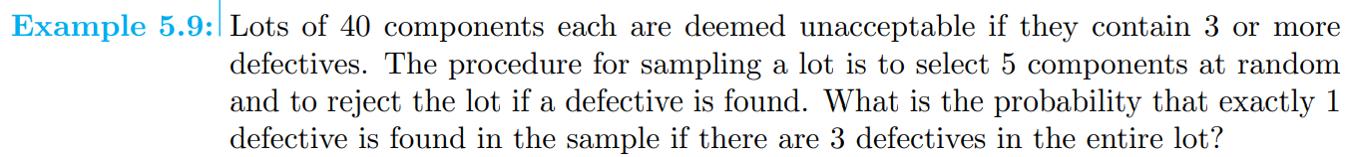
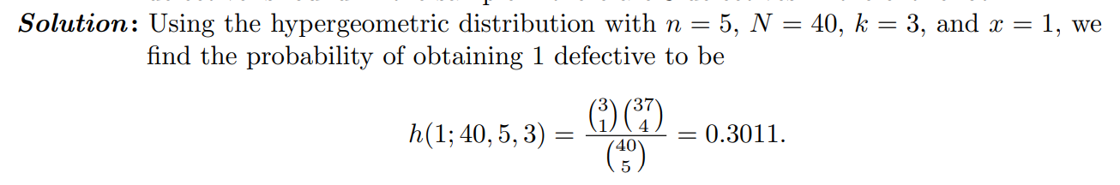

Slide 19
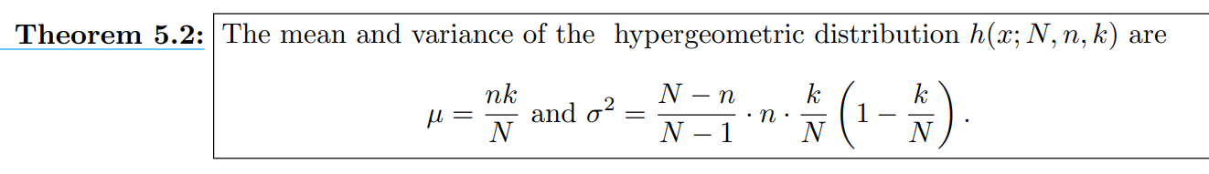
Mean and Variance of the hypergeometric distribution

Slide 20
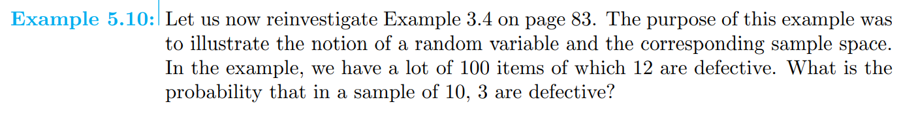

Slide 21
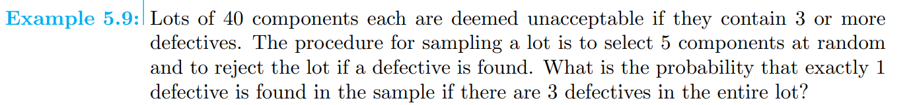

Slide 22
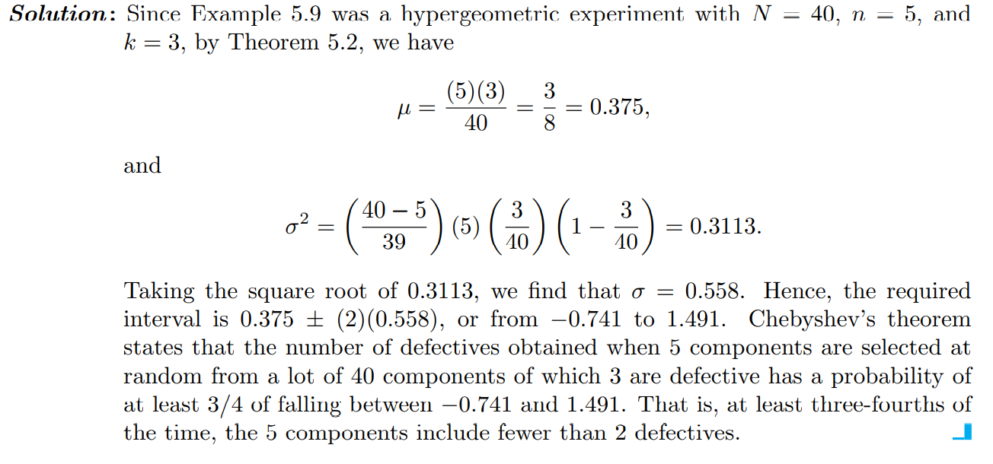

Slide 23
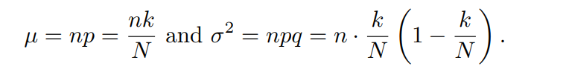
Relationship to the Binomial Distribution
if n is small compared to N, the nature of the N items changes very little in each draw.
So a binomial distribution can be used to approximate the hypergeometric distribution when n is small compared to N. In fact, as a rule of thumb, the approximation is good when n/N ≤ 0.05.
The quantity k/N plays the role of the binomial parameter p.
The variance differs by a correction factor of (N − n)/(N − 1), which is negligible when n is small relative to N.

Slide 24
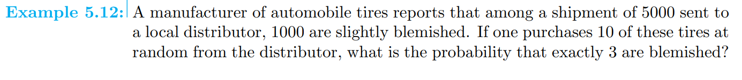
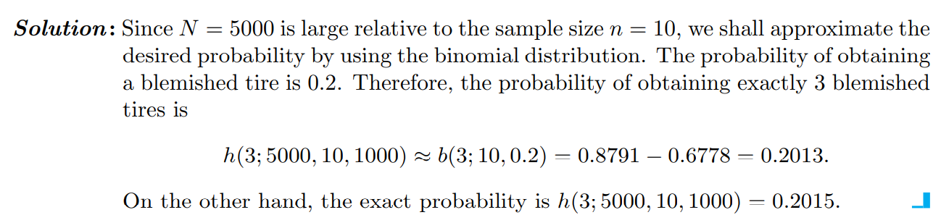

Slide 25

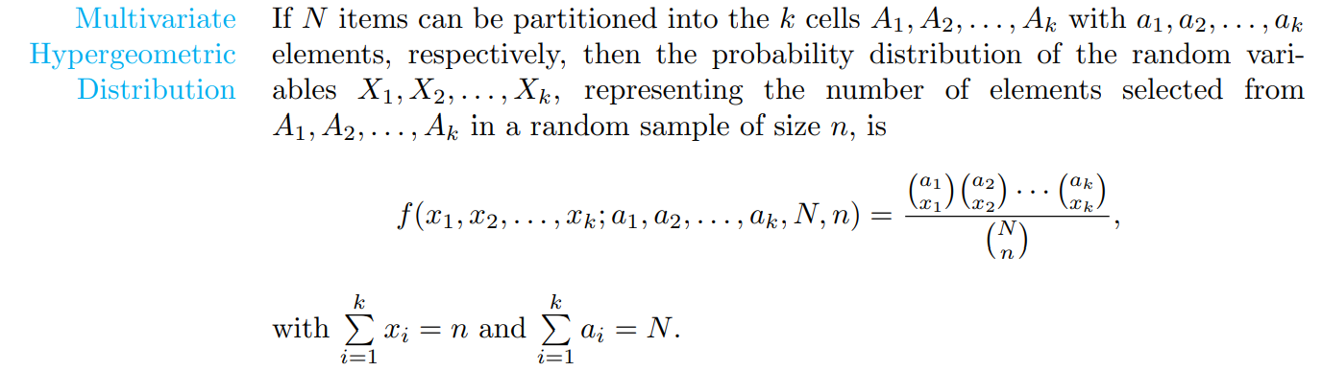
The hypergeometric distribution can be extended to treat the case where the N items can be partitioned into k cells A₁, A₂,...,A_{k} with a₁ elements in the first cell, a₂ elements in the second cell, ..., a_{k} elements in the kth cell. We are now interested in the probability that a random sample of size n yields x₁ elements from A₁, x₂ elements from A₂, ..., and x_{k} elements from A_{k}. Let us represent this probability by

Slide 26
